Slide 1


Navigating Through A Webinar
Technical Guideline
for Monitoring the Transformative Commitments of the New Urban Agenda

Slide 2


Slide 3

Get familiar with Zoom interface
3. Click Chat to view the Chat Window and text speakers or other participants.
1. Click the Mute/Unmute button to mute or use your microphone.
2. Click the Start/Stop Video bottom to transmit/ hide yourself.
4. Click here to react, including raise hand, clap, thumbs up, ect.

Slide 4
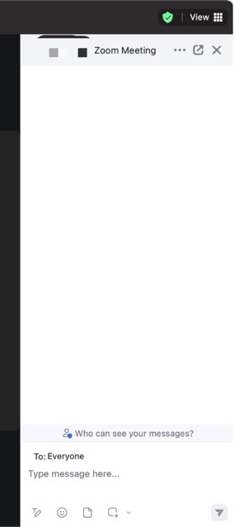

Get familiar with Zoom interface
5. Click here to change the Participants view to Speaker or Gallery View, and enter or exit the full screen mode.
6. Type inside the text box and press Enter or the paper plan icon to send a text to everyone.

Slide 5

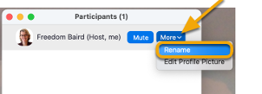
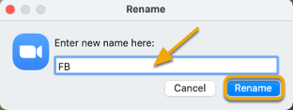
HOW TO RENAME
1. Click on the “Participants” icon in the Zoom toolbar.
2. In the Participants window, next to your name, click “More” and choose “Rename”.
3. Enter a new name and click “Rename” to save it for that meeting.
4. You will see the new name showing in the Participants window.

Slide 6
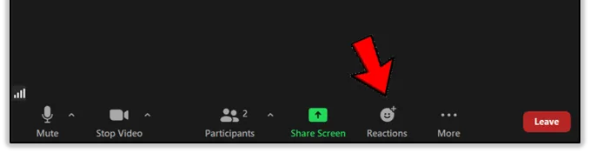
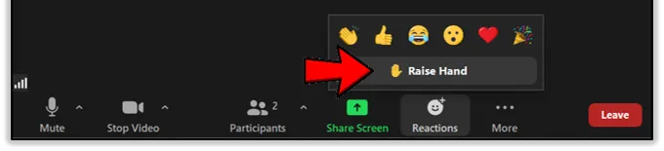
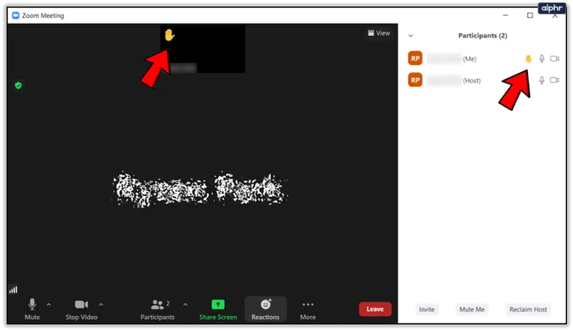
HOW TO RAISE HAND
1. Click on the “Reactions” section at the bottom of your screen.
Short Cut
Windows: press Alt+Y to
raise or lower your hand.
Mac: press Option/Alt + Y.
2. Click on the small icon in the shape of a hand, labeled “Raise Hand.”
3. Your hand is now raised, which means that the hosts and other participants will see that you have something to say.

Slide 7
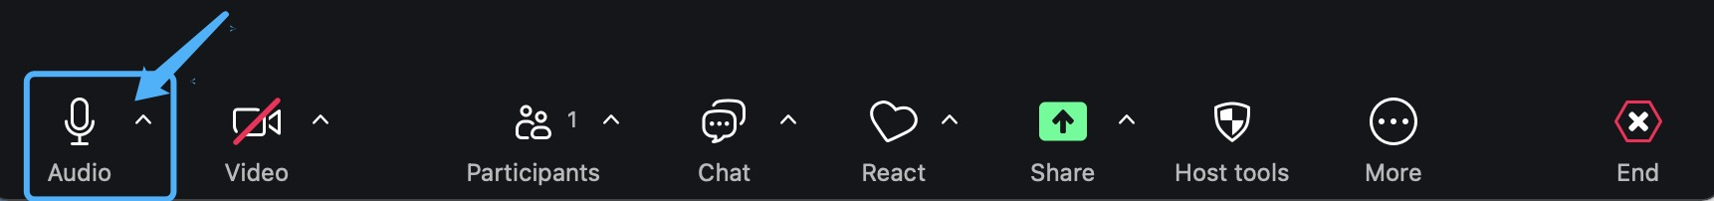


HOW TO Mute Yourself
1. Find the Audio icon at the bottom of the interface.
2. Click it to mute yourself.
3. Click again to unmute yourself.

Slide 8
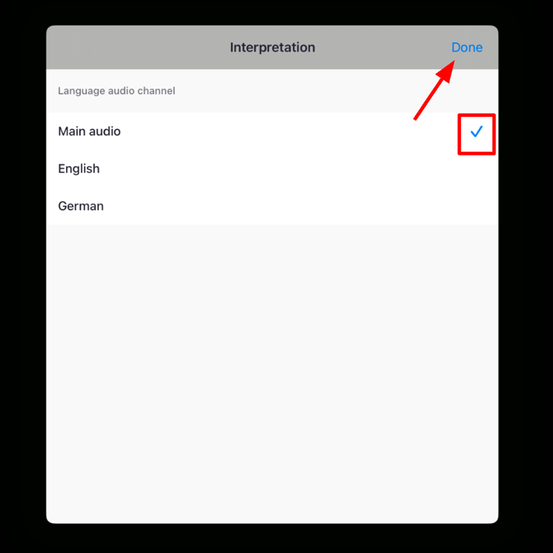
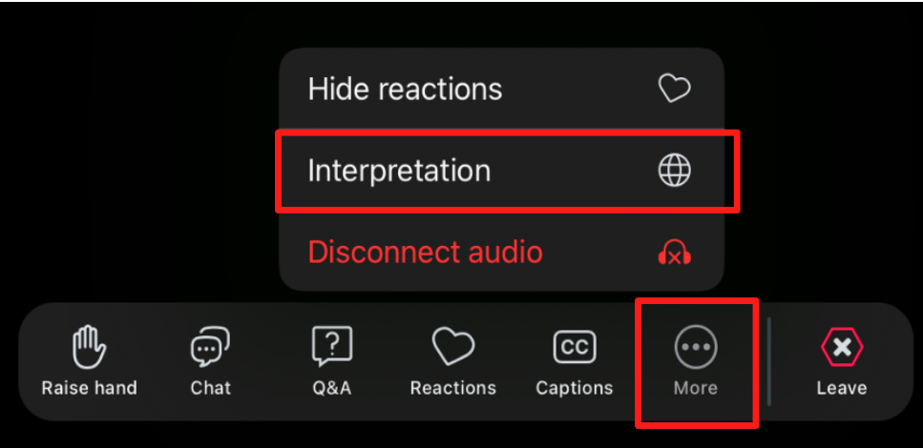
HOW TO Use Language Interpretation
1. Check to make sure that you are using the latest version of Zoom
2. Click it to mute yourself.
3. Click again to unmute yourself.
Step 2
Step 3

Slide 9


Slide 10
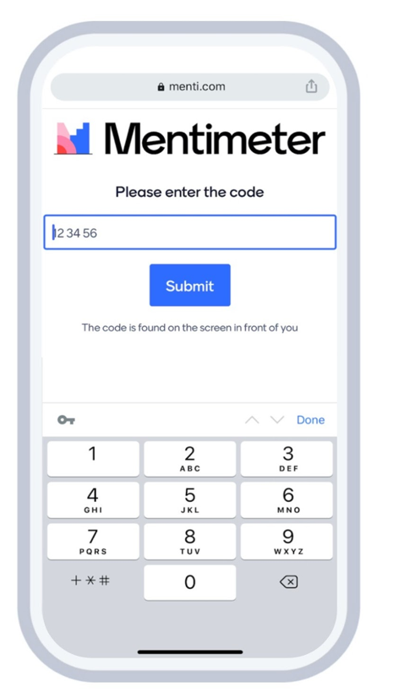
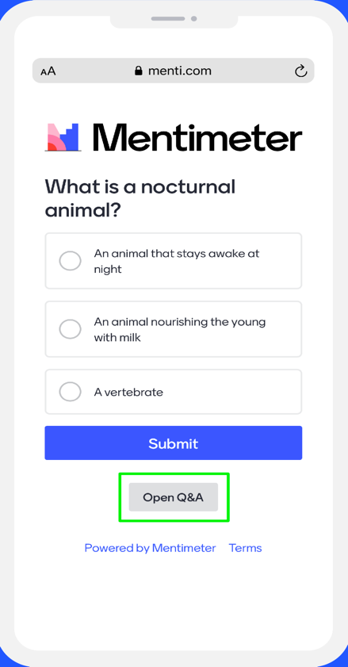
HOW TO PARTICIPATE (audience)
1. Go to www.menti.com and enter the code provided in the text field, or scan the QR code.
3. The questions will appear on your screen. Simply answer the questions and click “Submit”.
2. Click Submit.
🌟 For this webinar, click the link in the Zoom chat box to be redirected to Mentimeter.

