Slide 1
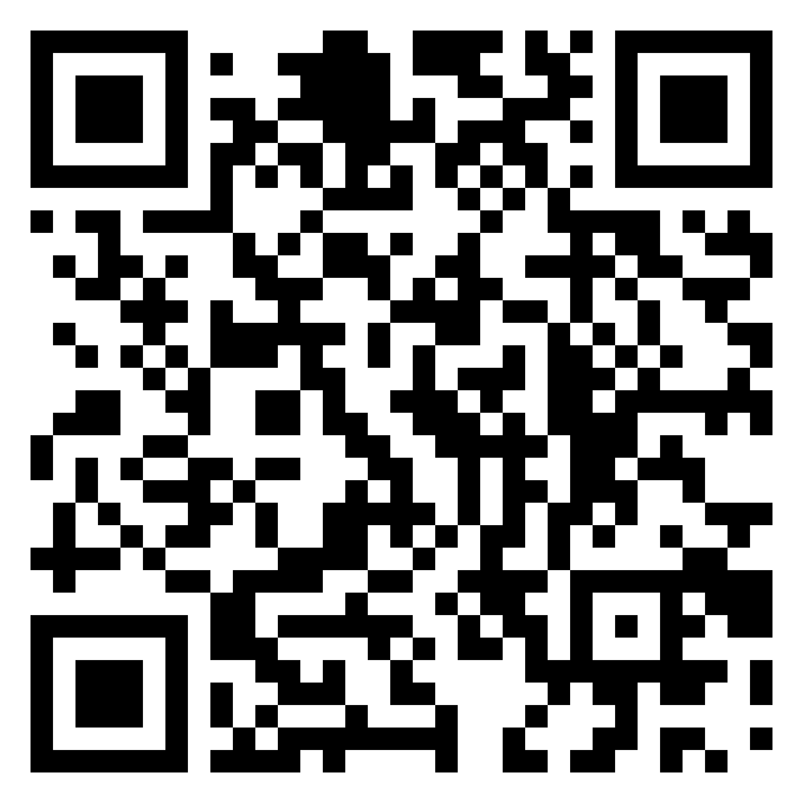
Webinar Title
Date: XXX

Slide 2
NOTE
For New Urban Agenda Visual Identity and the Branding Kit: https://unhabitat.org/implementing-branding-kit
Fonts downloadable at
Quicksand: https://fonts.google.com/specimen/Quicksand
Helvetica Neue (downloadable at: https://www.microsoft.com/en-us/download/details.aspx?id=106087)
if you do not have Helvetica Neue, replace it to Aptos
Roboto (downloadable at: https://fonts.google.com/specimen/Roboto)
Compress pictures (under File tab) to downsize the PPT file, and save as a PDF if needed

Slide 4
Engagement Rules
1. Mute Your Microphone
2. Rename yourself (Name and Duty Station)
3. Raise your hand to ask your Questions
4. Write Your Questions In the Chat
5. Turn Your Camera On When Asking Your Question
6. This Webinar Is Recorded
7. Keep your phone close by

Slide 5
Programme Agenda Sample
11.00-11.10
Openings
Facilitator Name
11.10-11.20
Keynote Speech
Keynote Speaker Name
11.20-11.40
Introductory Session
Speaker/s Name/s
11.40-11.55
Deep Dive 2
Speaker/s Name/s
11.55-12.20
Q&A
Facilitator Name
12.20-12.35
Deep Dive 3
Speaker/s Name/s
12.35-12.50
Q&A
Facilitator Name
12.50-13.00
Closing
Facilitator Name

Slide 6
INSERT THE PROFILE PICTURE HERE
Facilitation
Facilitator name
Job title

Slide 7
Panelists
Keynote Speaker
Facilitator
Job title
Job title
Presenter 1
Presenter 2
Presenter 3
Job title
Job title
Job title

Slide 8
Keynote Speech
TITLE
INSERT THE PROFILE PICTURE HERE
Keynote Speaker
Job title

Slide 9
Deep Dive
TITLE
Subtitle
Presenter 1
Job title
Presenter 2
Job title

Slide 10
Content
Allow non-Executive Board members to submit proposed agenda items. The joint bureau of governing bodies could meet and decide on the submitted proposals.
It would be useful to first give an overview of what OUTCONMES other than completing the statutory requirements of the EB are hoped for and then align the agenda to meet those outcomes.
Need to list all activities/budgets/results summarily of UN Habitat, then identify where guidance/decisions are needed according to RoP.

Slide 11
Title here
Can be more than one line but not more than 4 decks. Line after title
Title here
Can be more than one line but not more than 4 decks. Line after title

Slide 12
Title here / bullets can be double deck
Allow non-Executive Board members to submit proposed agenda items. The joint bureau of governing bodies could meet and decide on the submitted proposals.
It would be useful to first give an overview of what OUTCONMES other than completing the statutory requirements of the EB are hoped for and then align the agenda to meet those outcomes.
Need to list all activities/budgets/results summarily of UN Habitat, then identify where guidance/decisions are needed according to RoP.
Technology should allow an easier access to the updated agenda. During the plenum it should be shown on a screen which point of the agenda we are at.
The agenda should make provision for draft proposals from Member States on Salient issues before the session
The provisional agenda should be more pragmatic and problem-solving oriented, so the process of drafting it should be engaged by the Member States more actively and earnestly.

Slide 13
Title here / graphics examples
1 billion people live in informal settlements andslums in overcrowded and inadequate housing
2.4 billion people lack adequate access to safe water and sanitation
USD 72 million needed by UN-Habitat to help meet urgent needs in cities and communities in 64 countries

Slide 14
Title here / Table example
Response Areas | Africa | Arab States | Asia Pacific | Latin Global America Programmes |  | Total
 | 20 countries | 11 countries | 17 countries | 16 countries |  | 64 countries
1. Innovative community driven solutions | 25,890,000 | 16,160,000 | 9,000,000 | 700,000 |  | 51,750,000
2. Urban data, mapping and knowledge | 910,000 | 1,090,000 | 910,000 | 890,000 | 2,200,000 | 6,000,000
3. Mitigating economic impact and initiate recovery | 6,500,000 | 300,000 | 480,000 | 6,740,000 | 230,000 | 14,250,000
Total needs for 2020 | 33,300,000 | 17,550,000 | 10,390,000 | 8,330,000 | 2,430,000 | 72,000,000

Slide 15
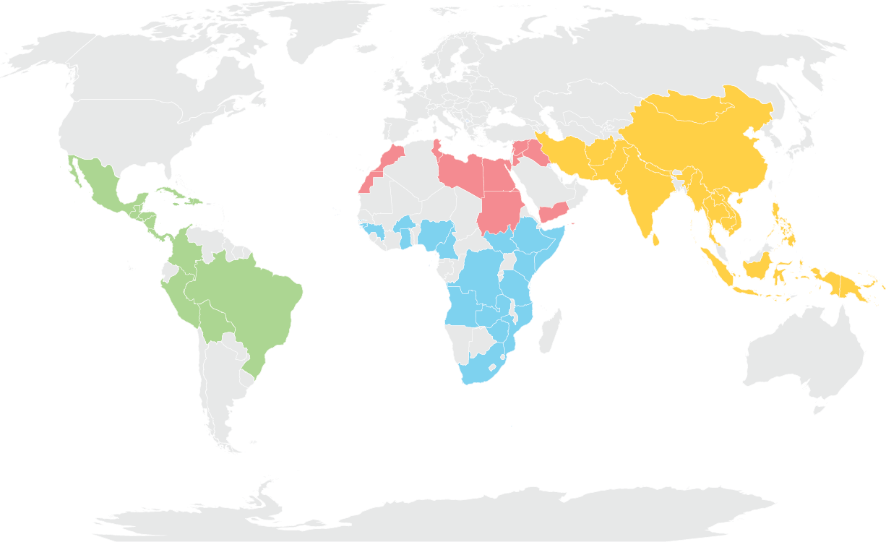
Title here / map example
Africa
US$ 33.3 M, 20 countries
Arab States
US$ 17.5 M, 11 countries
Asia Pacific
US$ 10.4 M, 17 countries
Latin America
US$ 8.3 M, 16 countries
Global Response
US$ 2.4 M

Slide 16
Q & A
Notes:
If you answered that you think the world is progressing either well or poorly on the agenda, we’d also like to hear more from you about why you think that, or more about what you consider as some of the biggest challenges to implementing the agenda.

Slide 17
THANK YOU!
Webinar Title

