Slide 1
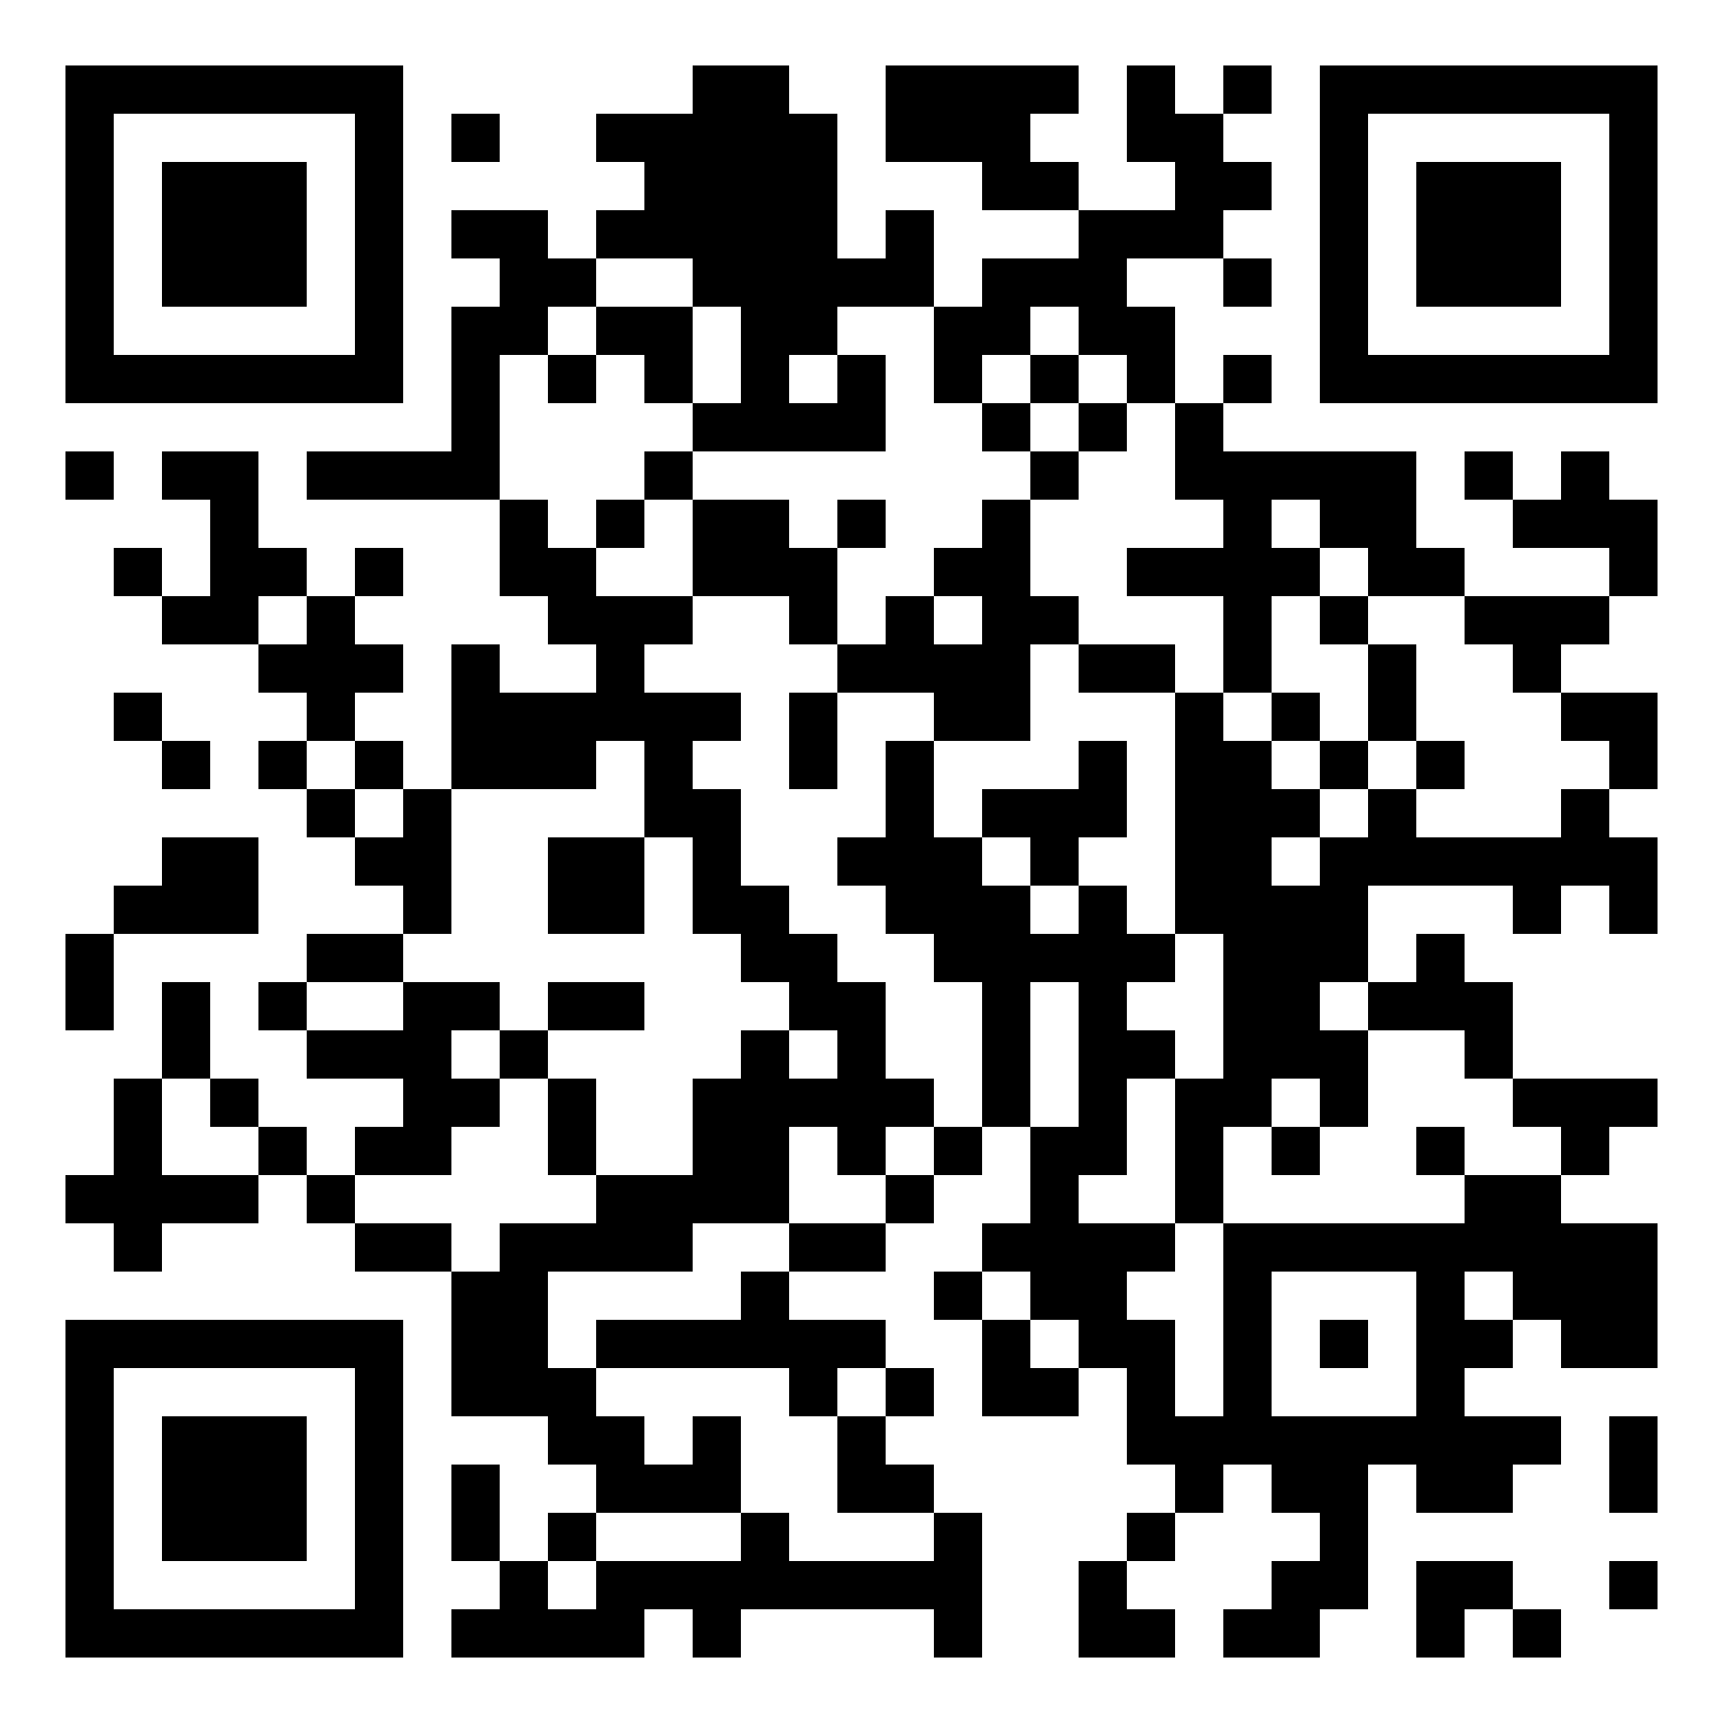
Monitoring
the Transformative Commitments of
the New Urban Agenda

Slide 2
NOTE
For New Urban Agenda Visual Identity and the Branding Kit: https://unhabitat.org/implementing-branding-kit
Fonts downloadable at
Quicksand: https://fonts.google.com/specimen/Quicksand
Helvetica Neue (downloadable at: https://www.microsoft.com/en-us/download/details.aspx?id=106087)
if you do not have Helvetica Neue, replace it to Aptos
Roboto (downloadable at: https://fonts.google.com/specimen/Roboto)
Compress pictures (under File tab) to downsize the PPT file (on-screen size recommended)
Save as a PDF recommended (Best for electronic distribution recommended)

Slide 4
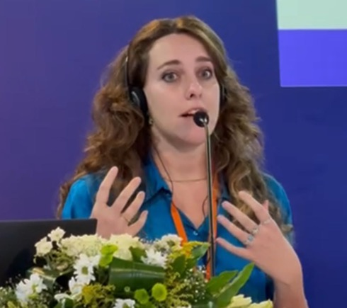
Facilitation
Anna Saracco
Instructional Design and E-Learning Expert Capacity Development and Training Unit
UN-Habitat HQ, Nairobi, Kenya

Slide 5
Engagement Rules
1. Mute Your Microphone
2. Rename yourself (Name and Duty Station)
3. Raise your hand to ask your Questions
4. Write Your Questions In the Chat
5. Turn Your Camera On When Asking Your Question
6. This Webinar Is Recorded
7. Keep your phone close by

Slide 6
Programme Agenda Sample
11.00-11.10
Openings
Facilitator Name
11.10-11.20
Keynote Speech
Keynote Speaker Name
11.20-11.40
Introductory Session
Speaker/s Name/s
11.40-11.55
Deep Dive 2
Speaker/s Name/s
11.55-12.20
Q&A
Facilitator Name
12.20-12.35
Deep Dive 3
Speaker/s Name/s
12.35-12.50
Q&A
Facilitator Name
12.50-13.00
Closing
Facilitator Name

Slide 7
New Urban Agenda Core Team
Edlam Abera Yemeru
Bobae Lee
Supervisor
Chief of the Knowledge Innovation Branch and Director of External Relations, Strategy, Knowledge and Innovation Division
Leader
Programme Management Officer
Matthijs van Oostrum
Matthew Benn
Juliet Motende
Team Member
Associate Programme Management Officer
Team Member
Programme Management Consultant
IT Focal Point
Senior Information Systems Assistant

Slide 8
How Much Do You know About NUA?
Scan the QR code
Join at: menti.com
OR

Slide 9
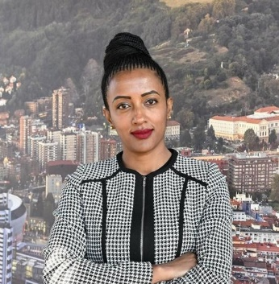
Keynote Speech
NEW URBAN AGENDA
AND ITS REPORTING 2026
Edlam Abera Yemeru (Ph.D)
Chief of the Knowledge Innovation Branch and Director of External Relations, Strategy, Knowledge and Innovation Division

Slide 10
Deep Dive
LET’S TALK NUA
Unpacking the New Urban Agenda reporting guidelines
Matthew Benn
Programme Management Consultant
UN-Habitat
Matthijs van Oostrum
Associate Programme Management Officer
UN-Habitat

