Slide 1
Deep Dive
LET’S TALK NUA!
A Q&A on the New Urban Agenda Reporting Guidelines
Matthew Benn
Programme Management Consultant
UN-Habitat
Matthijs van Oostrum
Associate Programme Management Officer
UN-Habitat
Notes:
Thanks Anna and Edlam, and thanks very much to everyone who made time to attend this webinar.
To introduce myself, my name is Matt Benn, I’m a Programme Management Consultant at UN-Habitat. I was part of the core team that put together the revised national reporting guidelines for the New Urban Agenda, and have been continuing to support our team’s work on the New Urban Agenda for this 2026 reporting cycle.
In the interest of time, I’m going to present all the information in this deep-dive session. However, I do want to invite my colleague Matthijs to quickly introduce himself as well as we’ll both be taking your questions on the reporting process, along with other colleagues on the team.
*Matthijs introduction*

Slide 2
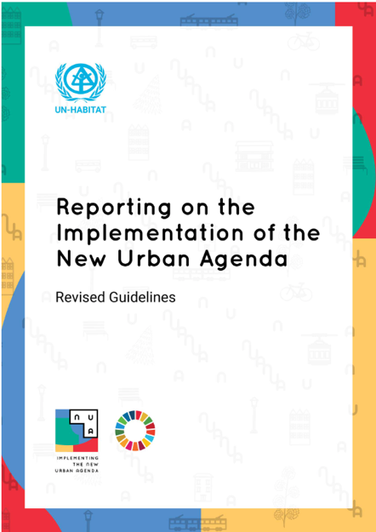
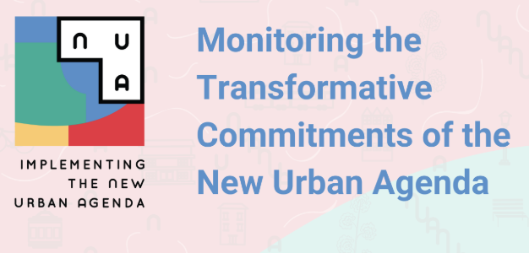
New reporting guidelines, e-learning, and webinar
Today’s webinar
April 2024
November 2024
February 2025
Notes:
So for this session, we’re hoping that most of you have taken our e-learning course on Monitoring the Transformative Commitments of the New Urban Agenda that we published in November last year (which is based on the revised national reporting guidelines that we prepared in April) so that we can save most of our time to answer your questions on the course and reporting process.
However, in case you haven’t taken the course yet or need a refresher, we’ve prepared some slides that provide a quick overview of the reporting process. And then once we’re done with this we’ll then turn it over to you all to engage with your questions.
In response to these challenges of the 2022 cycle, in April last year we released revised guidelines aimed at first providing national governments with both greater clarity and flexibility around the national reporting process.
In November last year we followed this up with the launch of the e-learning course that aimed to highlight the key principles and messages of the guidelines and make it more engaging, accessible and digestible.
Today, now in February 2025, the goal of this webinar is to promote further awareness of these resources and their key messages and to allow more interactive engagement and discussion.

Slide 3
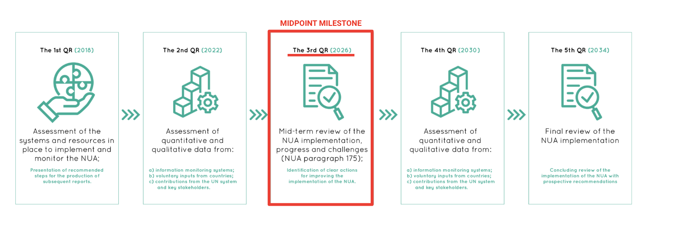
Quadrennial reporting on the New Urban Agenda
Notes:
What is reporting on the New Urban Agenda? Why do we have to do it?
New Urban Agenda requests the Secretary-General to take stock of our global progress on achieving the agenda every four years.
As the lead agency, at UN-Habitat we help the Secretary-General prepare the report by gathering evidence and input to determine our overall progress, with the most critical inputs to the report coming from the national progress reports submitted by Member States, that we will be discussing in this session.
It’s worth noting two key points as well:
First, while the first quadrennial report was technically released in 2018, since this came only two years after the adoption of the agenda, this one was really more of a baseline report; so instead our experience with quadrennial reporting is so far really informed by our experience around the last report in 2022.
Second, for our next quadrennial report due next year in 2026, it’s important to note that the New Urban Agenda specifically intends this report as a special mid-term of the agenda, where it is not only supposed to evaluate our progress on the agenda, but also evaluate the key challenges and recommend ways forward (identify further steps to address them).
As part of the Follow-Up and Review of the New Urban Agenda, the outcome document of Quito Habitat III conference invites the “General Assembly to request the Secretary-General, with voluntary inputs from countries and relevant regional and international organizations, to report on the progress of the implementation of the New Urban Agenda every four years".
2026 is the midpoint milestone for the New Urban Agenda marking 10 years since its adoption. Quadrennial report 2026 is a unique moment to take stock of the progress made, challenges faced, identify further steps to address them.

Slide 4
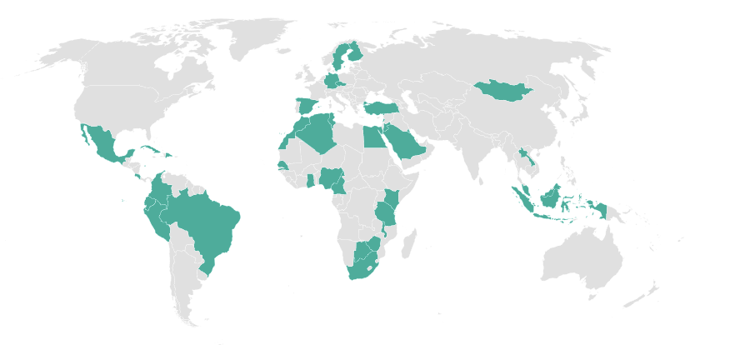
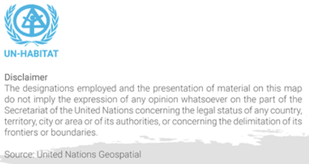
Challenges from the 2022 reporting cycle (1/2)
Too few report submissions in 2022
Member States need clearer guidance and more support to increase submissions for 2026.
20.6% submission rate
Notes:
Challenges with the 2022 reporting cycle

Slide 5
Challenges from the 2022 reporting cycle (2/2)
Reports not very useful for evaluating progress due to excessive focus on…
Project descriptions
Enumeration of projects
Only positive features

Slide 6
Four pillars of good reporting (1.2) introduced in 2024 guidelines
Project descriptions
Enumeration of projects
Realistic and evidence-based
Analytical
Connected with practice
Inclusive and transparent
Only positive features
Notes:
Four pillars of good reporting: UN-Habitat advocates for evidence-based, analytical, best practice-driven, and participatory reporting to support sustainable urban development and peer-to-peer learning among countries.
Effective reporting should be realistic and address challenges: countries are encouraged to provide a clear assessment of both successes and obstacles in their efforts to implement the NUA, allowing for informed adjustments to urban policies.
Inclusive and transparent reporting processes: reporting should involve multiple levels of government, ensuring open participation, particularly through National Urban Fora, to foster collaboration and transparency in NUA implementation efforts.

Slide 7
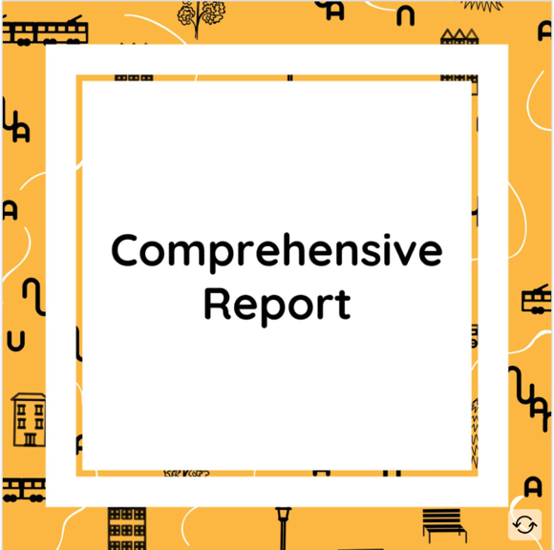
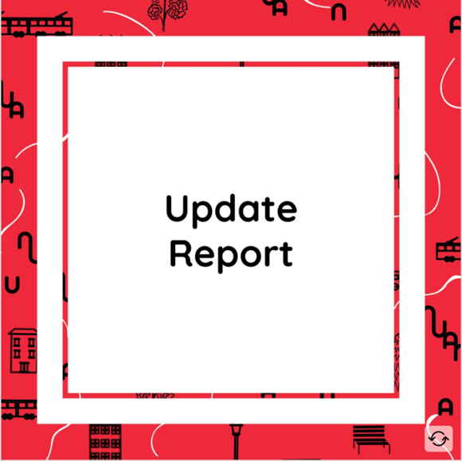
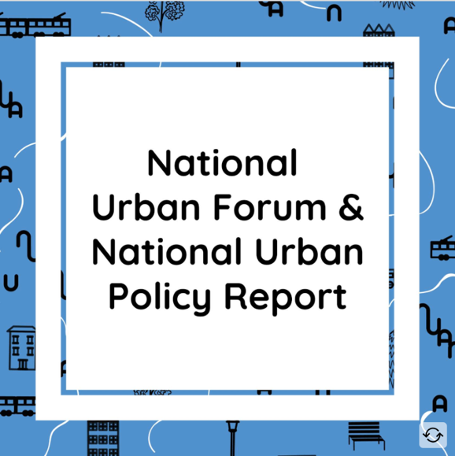
Three reporting modalities (1.1)
*New 2026 cycle*
*New 2026 cycle*
Notes:
The other major shift is we want to make reporting more efficient and reduce the burden faced by Member States.
Part of this is now having three different modalities for reporting on the New Urban Agenda:
1. The first option is the comprehensive report
Member States can face significant reporting burden on a broad range of global agendas with reporting requirements. The reporting can be reduced by leveraging other reporting processes that countries may already be engaged in, to generate input and analysis for a New Urban Agenda National Progress Report.
Governments can use urban forums to initiate a progress report on global agendas. In this modality, an urban forum is positioned as a tool to raise awareness and buy-in for the reporting process. The results will eventually be used to inform planning practice and feed into national urban policy.
2
Governments can use urban forums as platforms to engage with stakeholders from governments, civil society, private sector, academia and media to enhance the reporting process and ensure involvement of all multilevel actors. It will also help identify gaps in the progress report, capacity development, peer-to-peer learning, and enhancing bottom-up urban solutions.
3
Governments can use their urban forums to evaluate implementation of important recommendations, outcomes and results from a past reporting process. This gives an opportunity to assess role of the reports in accelerating implementation.

Slide 8
Leveraging other monitoring and reporting processes (1.3)
Agenda 2030
Data Initiatives
National Progress Report
Voluntary National Review (VNR)
Voluntary Local Review (VLR)
International Guidelines
Paris Agreement
Sendai Framework
Access to Basic Services
Urban & Territorial Planning
People-Centred Smart Cities
Biennial Transparency Report
Voluntary National Report
Notes:
In addition to the option to convert your NUF/NUP into a New Urban Agenda national progress report, we also wanted to highlight the overall connection between reporting on the New Urban Agenda and various other complementary monitoring and reporting processes.
Instead of duplicating efforts, where relevant to the New Urban Agenda, we strongly encourage governments to make use of the data, experiences and analysis produced for other reporting processes. The biggest and most obvious example of this is with the SDGs and Agenda 2030, given the deep connection between the New Urban Agenda and the urban components of the SDGs. This includes reporting done for Voluntary National Reviews and Voluntary Local Reviews.
Other examples include the Global Stocktaking and Nationally Determined Contributions under the Paris Agreement; contributions of cities and local governments to various urban data initiatives linked with the Urban Monitoring Framework, such as the Quality of Life Index; as well as monitoring and reporting on various international guidelines, such as the territoral and spatial planning guidelines and the recently launched 2025 international guidelines on people-centred smart cities.
---
When appropriately aggregated (VLRs) or disaggregated (VNRs, NDCs), data, analysis, and case studies/practices from other UN reporting processes can and should be leveraged for NUA NPRs to help reduce the reporting burden. Member States should welcome this as they have frequently expressed fatigue and concern about the high reporting burden for national governments and other stakeholders.
The NUA NPR process can in turn be used to inform each of these processes, including VNRs, VLRs, our NUPs, and the Global Stocktaking process that is occurring around NDCs to meet the objectives of the Paris Agreement. Linkages with these other processes can also help to improve mainstreaming of the New Urban Agenda.

Slide 9
Examples of suggested data indicator (2.1 – 2.4)
Housing, basic services and social inclusion (2.1.)
Urban economy and prosperity (2.2.)
Urban resilience, biodiversity, and environment (2.3)
Effective implementation (2.4)
Slum proportion
Gini coefficient
Local DRR strategy
Planners per capita
% Public open space
Unemployment rate
GHG emissions
Participatory planning processes
% Access to basic services
% Own-source city revenue
Land consumption rate
% Women in local government

Slide 10
Strategic ways forward (2.5)
What key actions is your country planning to implement from now until 2036 to achieve the New Urban Agenda?
What aspects of implementation have been most lacking and need to improve to enable achievement of the agenda?
How can political commitment be secured at all levels of government to accelerate implementation of the agenda?
Notes:
Refer to Section 2.5
Emphasizing special nature of report as mid-term review
Last report in 2022 not very positive/rosy; if things haven’t improved since last report, need to seriously think about what we need to do to achieve this
Which key actions in your country planning to implement in the period up 2036 to achieve the transformative commitments within the New Urban Agenda?
Which aspects of implementation have so far been lacking the most and need to improve to enable achieving the transformative commitments? What are the ways in which adequate political commitment at all levels of government can be secured to accelerate the implementation of the New Urban Agenda?

Slide 11
2026 reporting cycle timeline
Final release of SG report
NUA NPR deadline
Draft SG report
Today
WUF13
High-Level Meeting on the Implementation of the New Urban Agenda
2025
2026
INPUT COLLECTION
SYNTHESIS
REVISION
CLEARANCE
Notes:
-Inputs for reporting will be used in broader reporting processes, e.g., SDG 11 report, WCR, extended report?
-High-level meeting on the New Urban Agenda;

Slide 12
Q & A
Questions about the reporting process?
Tell us more about your mentimeter responses.
For example, why do you think the world is progressing either well or poorly on the New Urban Agenda?
Notes:
Want to now turn it over to you to for questions about the reporting process.
If you answered that you think the world is progressing either well or poorly on the agenda, we’d also like to hear more from you about why you think that, or more about what you consider as some of the biggest challenges to implementing the agenda.

Slide 13
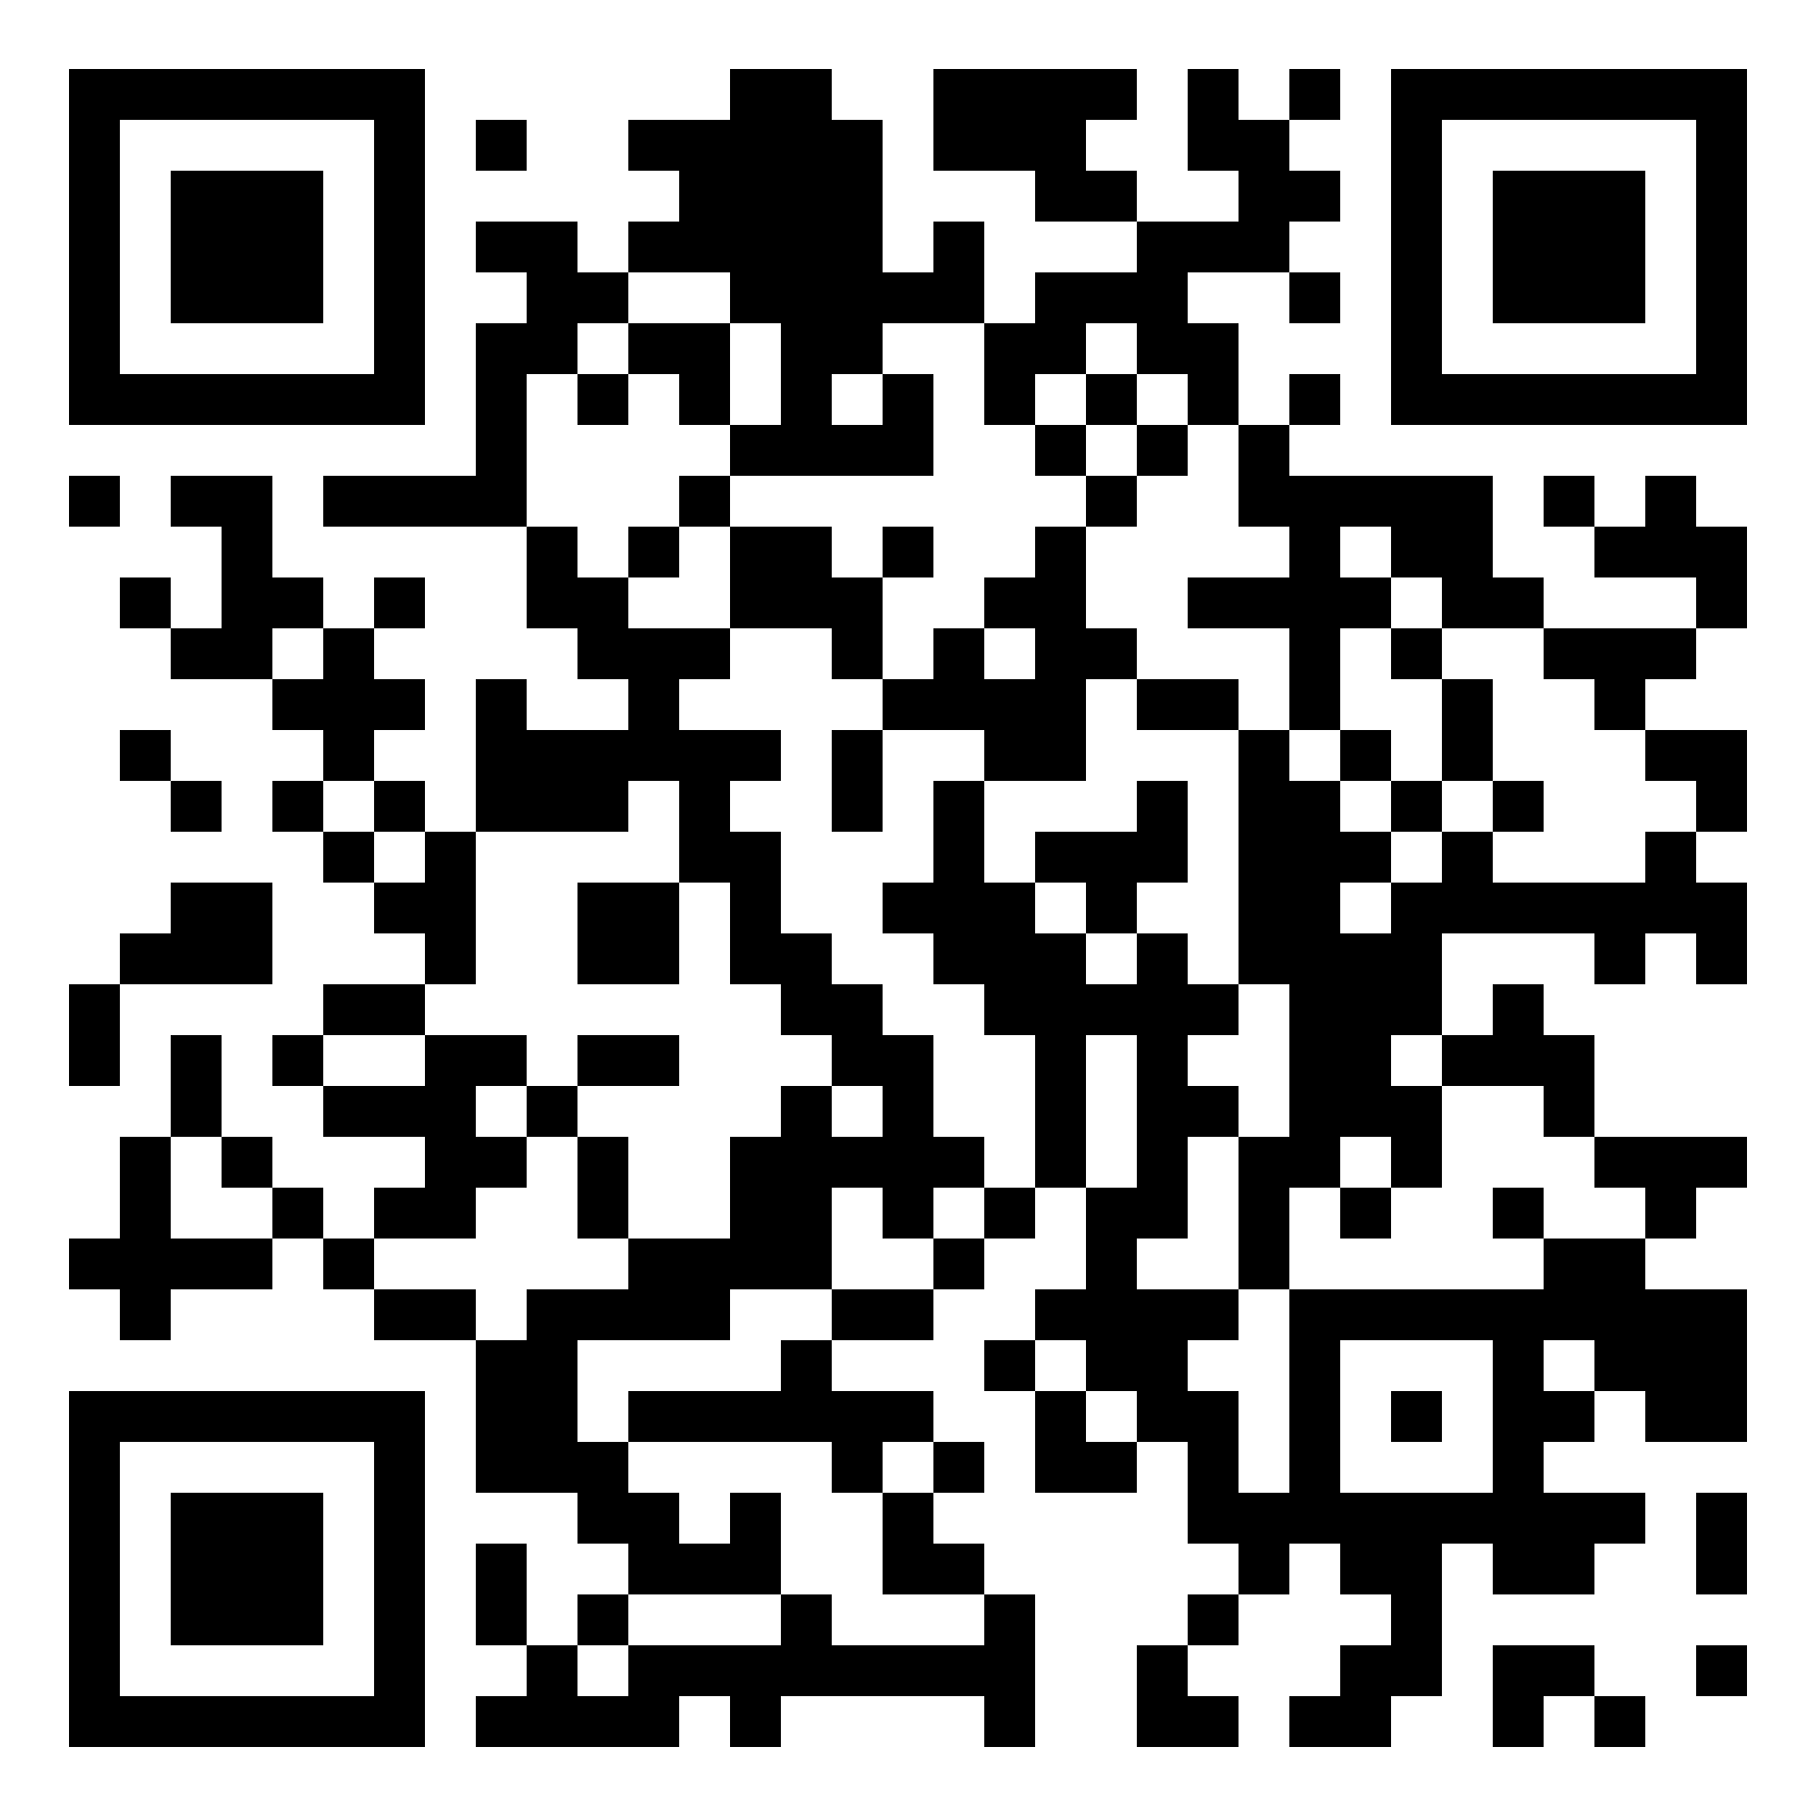
THANK YOU!

