Slide 1
Deep Dive
HOW TO PREPARE
A NEW URBAN AGENDA NATIONAL PROGRESS REPORT
Nagwa Lachine
Programme Officer, SDG Localization & New Urban Agenda Advancement Programme, UN-Habitat Regional Office for Arab States
Nihal El-Megharbel
Former Vice Minister of Planning, Monitoring and Administrative Reform, Egypt

Slide 2
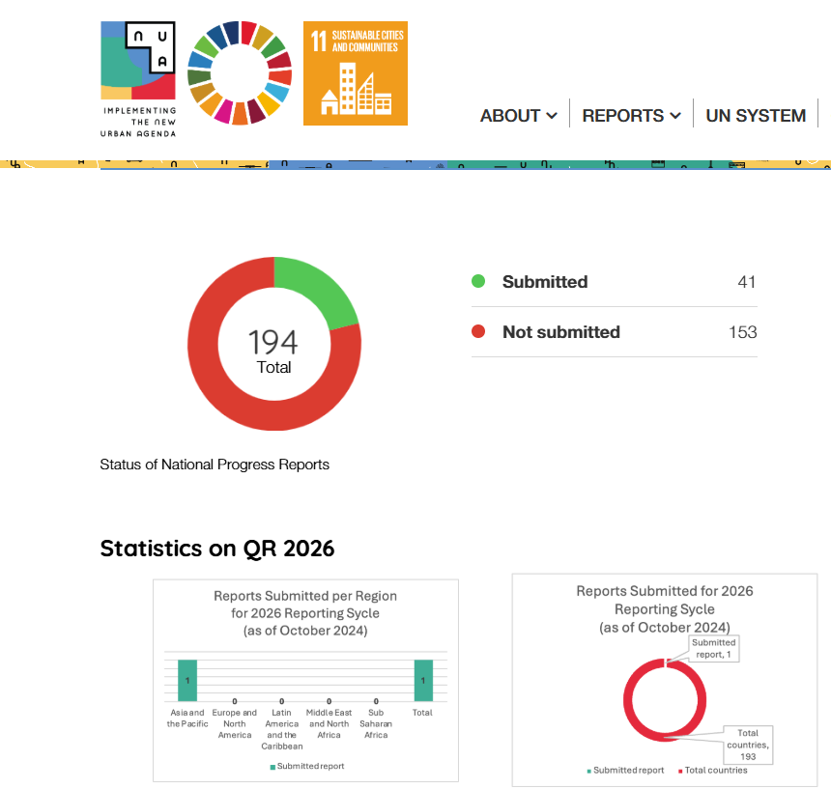
NUA MONITORING REPORTS IN THE ARAB REGION
First reports
10 Arab States submitted their first National Voluntary Report (2016-2020)
Algeria | Bahrain | Egypt | Jordan | KSA
Kuwait | Lebanon | Morocco | Palestine | Tunisia
22

Slide 3
NUA MONITORING REPORTS IN THE ARAB REGION
Key Findings
- Significant interest in urbanization issues and their importance.
- Good understanding of the challenges facing urbanization.
- The need to address challenges through collective efforts, joint coordination, and regional and international cooperation.

Slide 4
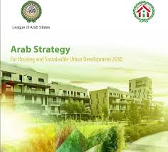
NUA and ASHSUD
A Tale of 2 Strategies

Slide 5
NUA and ASHSUD
Vision
Member countries can inhabit and produce just, safe, healthy, accessible, affordable, resilient, and sustainable cities and human settlements, to foster prosperity and quality of life for all.
Member countries are able to develop integrated and sustainable human settlements, resilient and competitiveness, providing a better quality of life in the Arab world.

Slide 6
NUA and ASHSUD
3 Main Pillars
6 Goals
Transformative commitments for sustainable urban development
(1-1) Sustainable urban development for social inclusion and ending poverty
(1-2) Sustainable and inclusive urban prosperity and opportunities for all
(1-3) Environmentally sustainable and resilient urban development
Effective implementation
(2-1) Building the urban governance structure
(2-2) Planning and managing urban spatial development
(2-3) Means of implementation
Follow-up and review
Ensuring universal access to adequate, safe, and affordable housing and basic services, and achieving well-being
Achieving development equity and social inclusion
Planning integrated and sustainable human settlements in all countries of the Arab region
Applying the principles of good urban governance and capacity building for planning and managing human settlements
Improving urban environmental sustainability, enhancing resilience to climate change, and protecting natural resources
Enhancing urban productivity to achieve economic growth and sustainable development at the national and regional levels

Slide 7
NUA and ASHSUD
Principles
Both plans represent an integrated framework for strategic urban planning | Include a vision, strategic objectives, and implementation mechanisms over a long-term
 | Depend on innovation, to create a comprehensive transformation and a qualitative leap towards sustainable urban development, with humans as the central pillar
 | Consider the irreversible and indivisible rapid urban growth in light of resource and capacity constraints that challenge the urbanization process
 | Focus on responding to fast-moving events, managing change, and improving the quality of life
 | Outline growth and urban expansion directions, mechanisms to sustain and develop the city's existing economic base, enhance its competitiveness
 | Implement programs to protect and improve the quality of life for city residents
 | Consider environmental factors and address climate change challenges
 | Follow a participatory approach that involves all relevant levels and stakeholders, and adopt policy-based evidence
 | Emphasize continuous development and dynamism, practical implementation, and a forward-looking approach to anticipate future developments
 | Promote flexibility, responsiveness, and resilience by balancing the considerations of city growth and development with environmental factors, while anticipating crises and challenges that may hinder the achievement of the city's future goals

Slide 8
NUA and ASHUSD
Common Reporting
NUA | ASHSUD
(1-1) Sustainable urban development for social inclusion and ending poverty | 1. Ensuring universal access to adequate, safe, and affordable housing and basic services, and achieving well-being
 | 2. Achieving development equity and social inclusion
(1-2) Sustainable and inclusive urban prosperity and opportunities for all | 6. Enhancing urban productivity to achieve economic growth and sustainable development at the national and regional levels
(1-3) Environmentally sustainable and resilient urban development | 5. Improving urban environmental sustainability, enhancing resilience to climate change, and protecting natural resources
(2-1) Building the urban governance structure (2-3) Means of implementation | 4. Applying the principles of good urban governance and capacity building for planning and managing human settlements
(2-2) Planning and managing urban spatial development | 3. Planning integrated and sustainable human settlements in all countries of the Arab region

Slide 9
NUA and ASHUSD
Common Reporting: Technical Assistance
ROAS created awareness among Arab States’ representatives in LAS about the importance and effectiveness of common reporting mechanism.
ROAS and UNHABITAT Countries’ offices held capacity building and orientation workshops to explain the synergies between the 2 log-term plans, and the methodology to develop a common reporting mechanism.
ROAS is developing a tool kit/manual to prepare comprehensive, evidence-based, and analytical monitoring reports.
The tool kit/manual adopts a participatory, multi-level, multi-stakeholders, inclusive, and transparent methodology, that promotes the use of new technology and big data.
Technical assistance is also provided for all member States, and a “Regional Monitoring Report” is envisioned.
The expected outcomes include building in house capacities to support the continuous reporting for NUA and ASHSUD, stimulating effective coordination between different stakeholders, and improving data collection and computation of indicators.

Slide 10
Q & A

Slide 11
THANK YOU!

