Slide 1
Deep Dive
Harnessing Data for Urban Insights: Observatories and the Urban Monitoring Framework (UMF)
Robert Ndugwa
Chief, Data and Analytics Unit
Notes:
Discussion areas
Urban observatory network activities
Urban observatories supporting SDG 11+ monitoring and reporting
Urban observatories certification
GUO network management and related

Slide 2
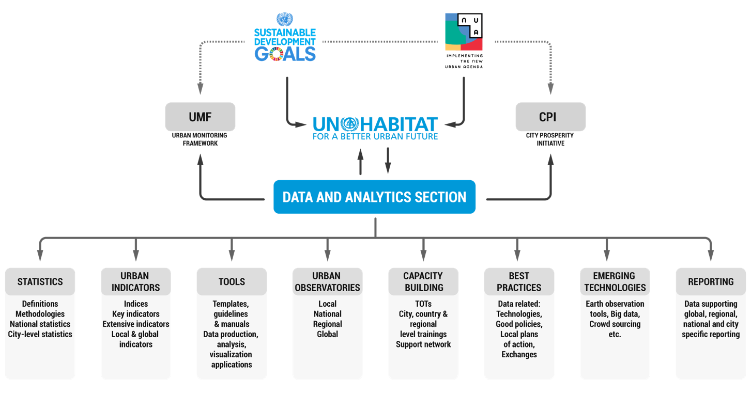
About the Data and Analytics Unit, UN-Habitat
Our focus areas
Focal point for sustainable urbanization data within the SDGs
Oversee data production, capacity development and reports production
Lead development of tailor-made solutions to measure urban development trajectories and conditions

Slide 3
Background to the Urban Observatory Model
Many cities face major disconnects between data production and decision-making processes
Lack of good quality, relevant, accessible and timely data on cities
Too much information that is not well-linked, complexities in data collection and management
Hence the Urban Observatory model was created to:
Assist countries in strengthening data capacities at national, sub-national, and local levels, providing platforms to facilitate effective knowledge exchange and promote evidence-based governance.

Slide 4
What is an urban observatory?
A local network and integrated system for producing, analyzing, disseminating data across indicators and its use for informed decision-making at local level
Constitutes both a process and a platform
Create sustainable urban monitoring systems in support of local planning and management processes, linking data to policy
Strengthen local capacity for the development and use of urban indicators that facilitate the collection of disaggregated data at city and sub-city levels
Specific Aims
Promote local ownership of urban indicator systems and a culture of monitoring and assessment in the urban sector.

Slide 5
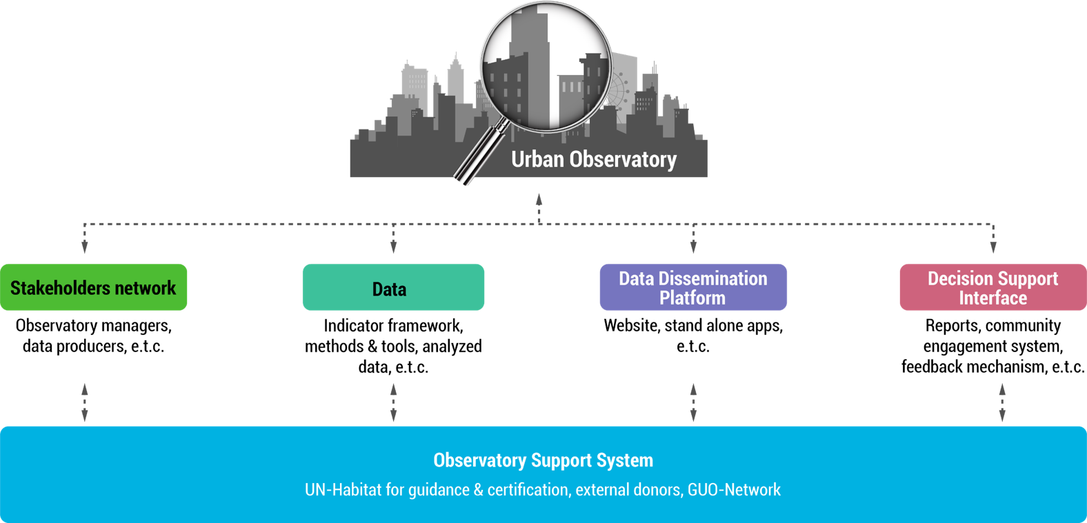
How an urban observatory works….Five key components

Slide 6
Steps in setting up an urban observatory
PLANNING
CERTIFICATION
INITIATING THE OBSERVATORY
OBTAINING CERTIFICATION
Step 1: Identify need/ purpose of the observatory
Step 2: Nominate host institution
Stakeholders mapped and team formed
Step 14: Initiate certification process
ENGAGING STAKEHOLDERS AND FORMING TEAMS
Action plan includes scope, results and sustainability plan
Step 3: Identify actors & Stakeholders
Step 4: Select primary composition of the observatory ( Steering committee, technical team etc)
IMPLEMENTATION PLAN
Capacity built
CREATING A STRATEGIC ROADMAP
Step 10: Develop clear and concrete action plan
Step 11: Specify level of intervention
Step 12: Describe expected results
Step 13: Develop a sustainability plan
DEFINING THE OBSERVATORY'S DIRECTION
Step 5: Define objectives and vision
Step 6: Identify sectorial focus
Stakeholders mapped, team formed and objectives set
BUILDING NECESSARY CAPACITIES
Step 7: Identify skills required for objective
Step 8: Assess capacity
Step 9: Build capacity
Notes:
The process is non-linear and includes many considerations and overlapping steps

Slide 7
Interactions between different urban observatory levels
GUO
Different observatories are housed at different places​
LUOs - existing city department, non-governmental organization or university. ​
NUOs – statistical offices, ministry in charge of planning / urban development, research institute​
GUO –UN-Habitat
​
Localization of global and National agenda / Local monitoring
Data production and aggregation
NUO
NUO
NUO
LUO
LUO
LUO

Slide 8
Urban Observatories are connected through the GUO-Network
A worldwide network of urban observatories at different levels, aimed at sharing knowledge and supporting implementation of urban agendas at the national and local levels.
Technical guidance
Inform
Share
Facilitate partnerships
Guide policy formulation
Provide Technical guidance to LUO, NUO and RUO in urban planning and policy issues
Improve information flows between all levels for better urban decision-making
Share best practices and lessons learnt
Facilitate partnership agreement
Guidance in informed policy formulation
GUO-Network is managed through a steering committee, recommended by the network members and constituted in 2022

Slide 9
UN-Habitat’s support
Supporting UOs setup and capacity development
Monitoring frameworks
Institutional assessments and needs assessment consultations
Partnerships
Certification process
Relationships with wide range of urban stakeholders and other urban observatories to learn from past experiences regarding methods and approaches
+
Overall coordination of GUO-Net activities
Capacity building activities on UO set up and monitoring needs
Development of guides and manuals on monitoring needs at the local level based on global standards eg UMF
Support UOs to identify institutional partners and personnel and conduct initial needs assessment activities.

Slide 10
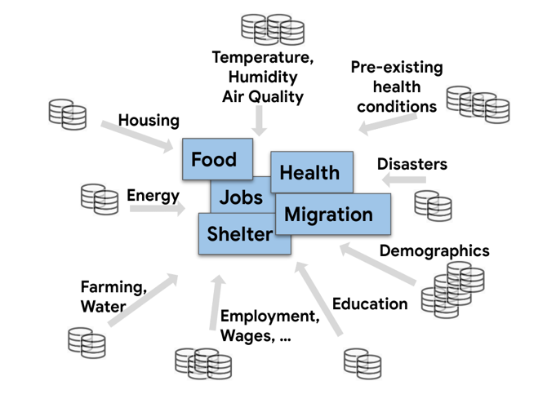
Why the Global Urban Monitoring Framework
Many of the big challenges we face — climate change, increasing inequities, epidemics of diabetes — will need deep, holistic insights (data) to solve for urban areas.
Complex challenges don't get solved with a single data source
Data fragmentation gets in the way of being used to make a big difference.
Climate change in cities • Example
Notes:
Mission and Vision
Mission: Organize all the world’s public data making it universally accessible and useful
Vision: Empower every person (KOF, employee, decision maker, general public) to make better, responsible, data aware decisions
Bold: by having every organization adopt a federated, interoperable Data Commons instance that gets their data streams in Schema.org formats
Responsible: With a T&S lens that those decisions are responsibly driven.

Slide 11
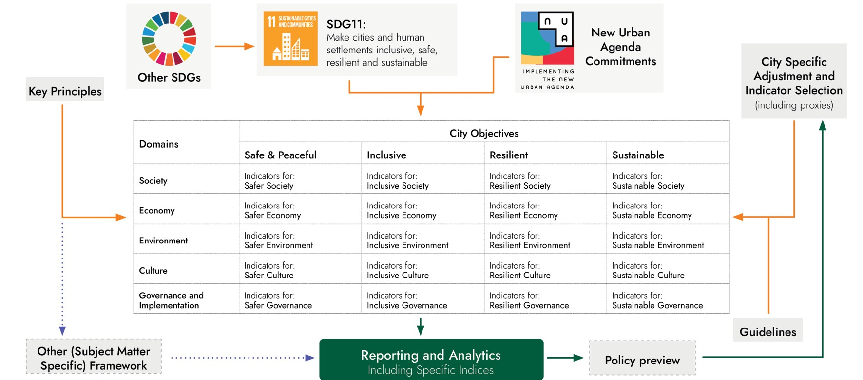
The Global Urban Monitoring Framework

Slide 12
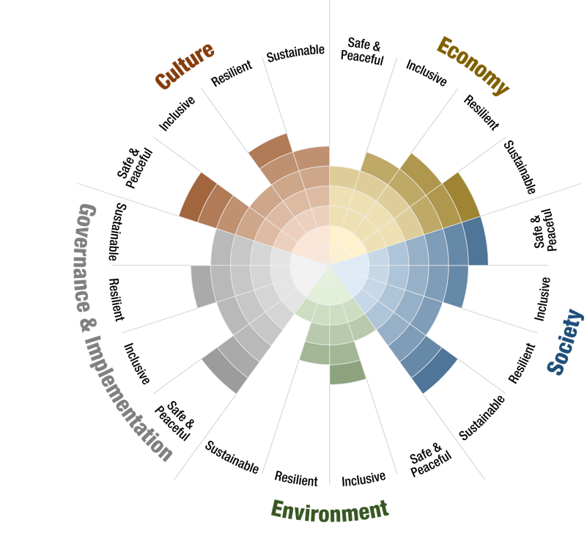
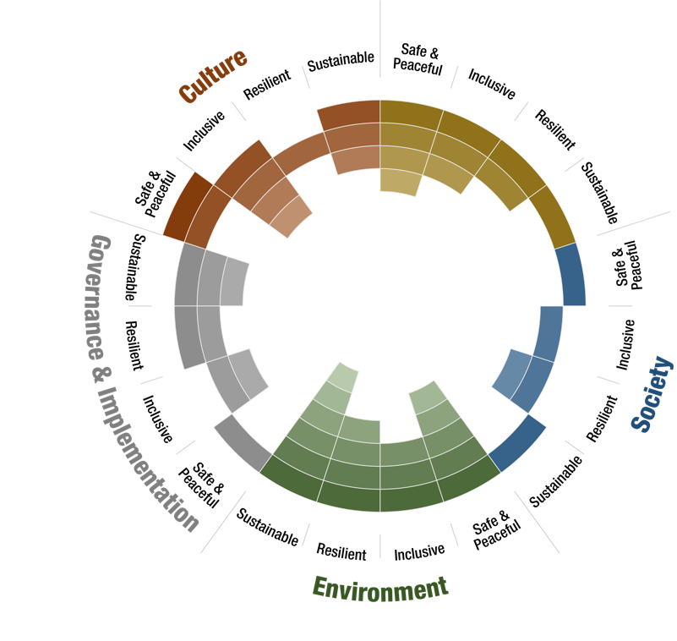
The UMF helps link monitoring to local actions
Gaps & Actions
Identification

Slide 13
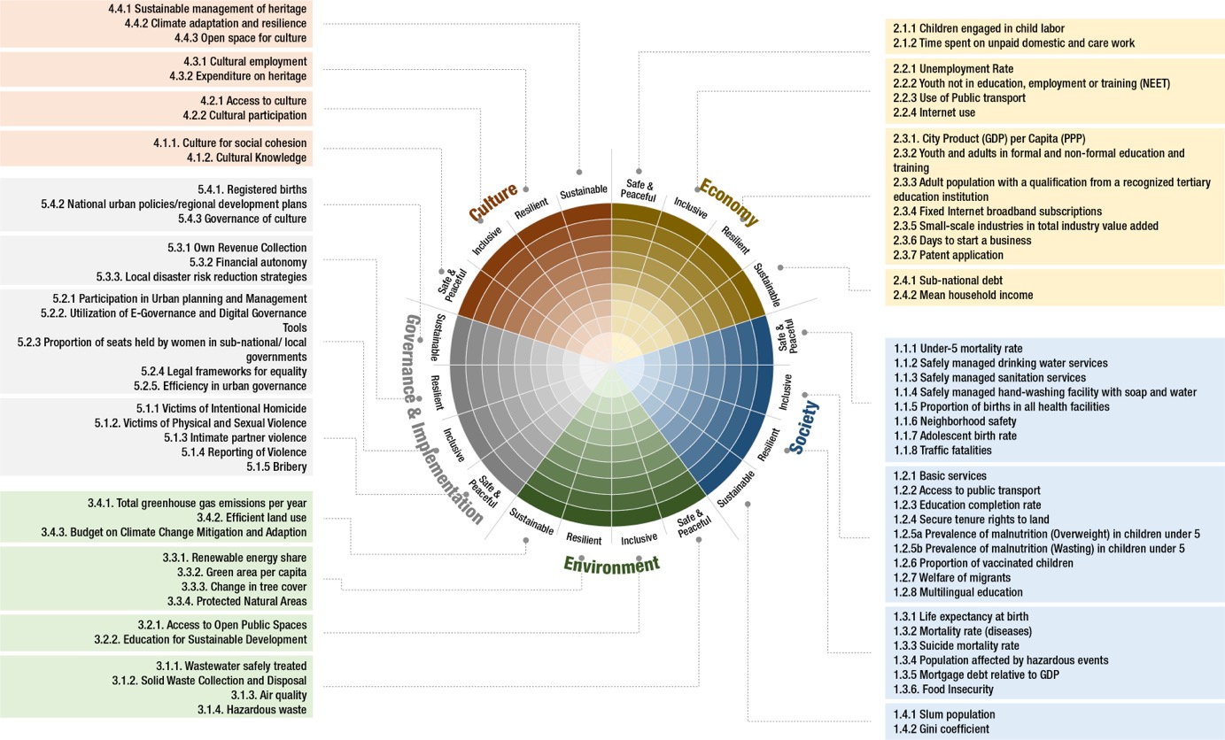
The UMF Wheel Diagram

Slide 14
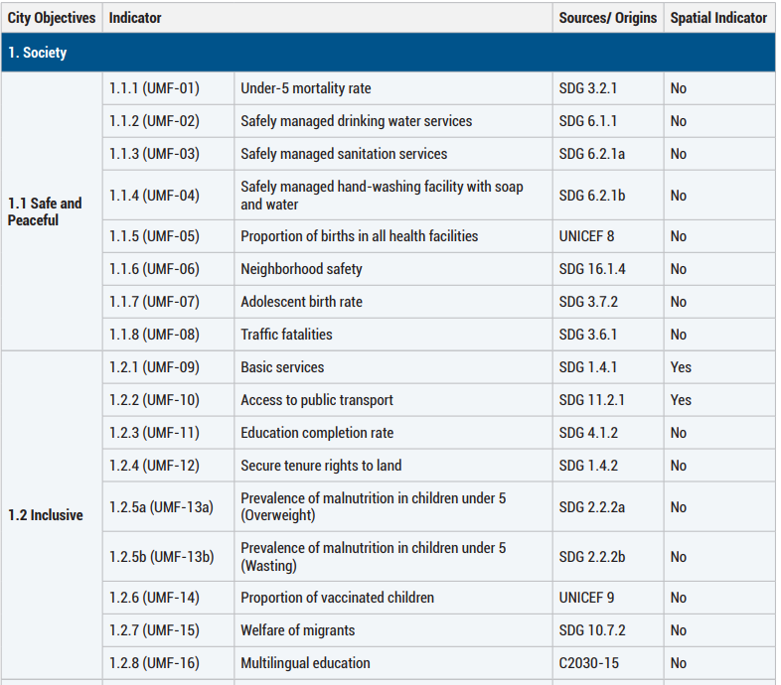
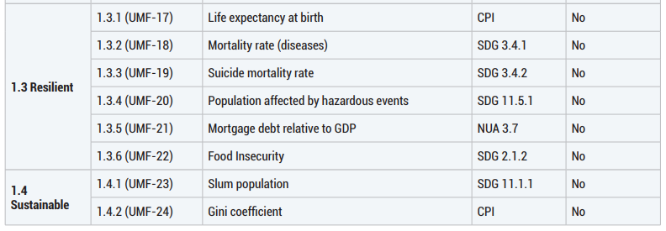
The UMF Adapted Indices & SDG Alignment
City Prosperity Index (CPI)
Has now been replaced by the UMF.
Quality of Life Initiative
Economist Impact –
Urban Performance Index (UPI)
Shanghai UMF Adapted Index (SAI)

Slide 15
Some examples of urban observatories
Gauteng City-Region Observatory, South Africa
Main areas of work
Launched September 2008
Institutional collaboration between:
Gauteng Provincial Government
Organised local government in Gauteng
University of the Witwatersrand (Wits)
University of Johannesburg (UJ)
Funded with a core grant from the Gauteng Premier’s Office, with UJ and Wits contributing additional in-kind support
On request policy work
Data, indicators and benchmarks
Medium to long term research
Academic contributions
Partnership and networks
Government – academia portal
www.gcro.ac.za
Slide credits: GCRO

Slide 16
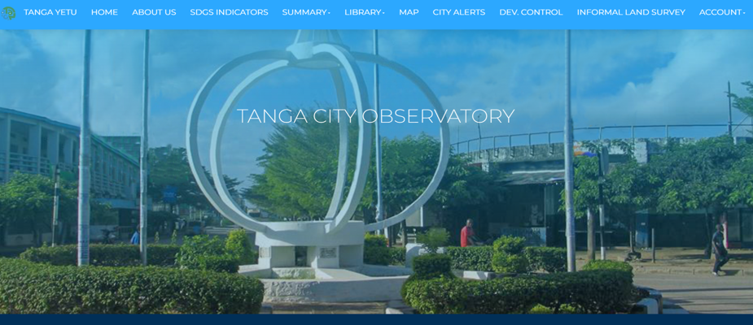
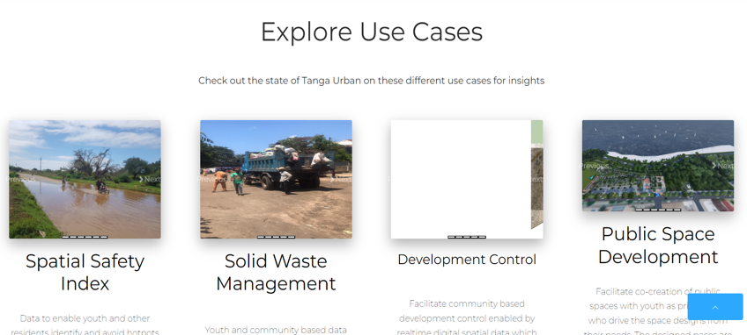
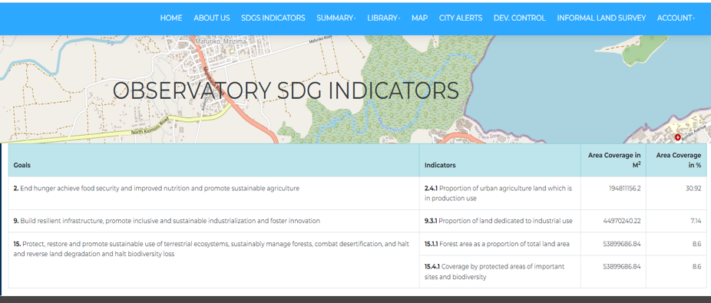
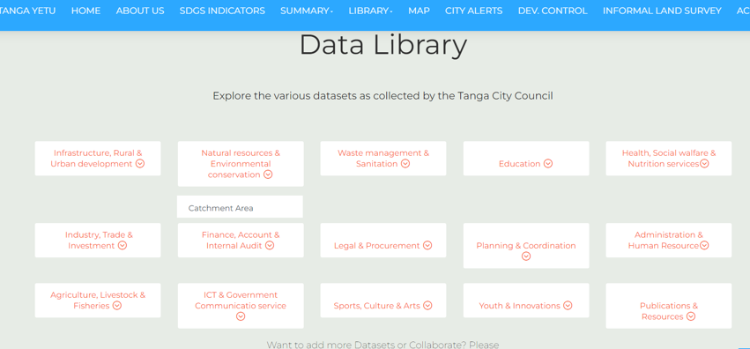
Some examples of urban observatories
Tanga City Observatory, Tanzania
https://tanga.cityobservatory.or.tz/

Slide 17
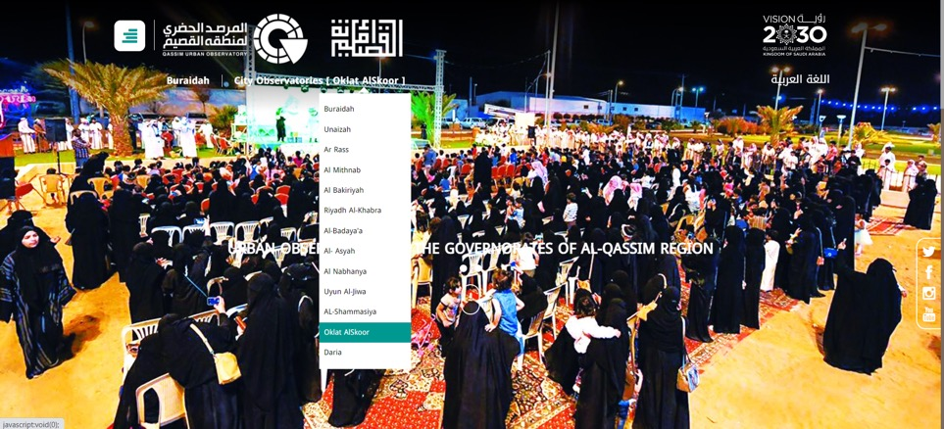
Some examples of urban observatories
Qassim Urban Observatories, Saudi Arabia
https://portal.marsad-buridah.com/Pages/2/101/Home
https://tanga.cityobservatory.or.tz/

Slide 18
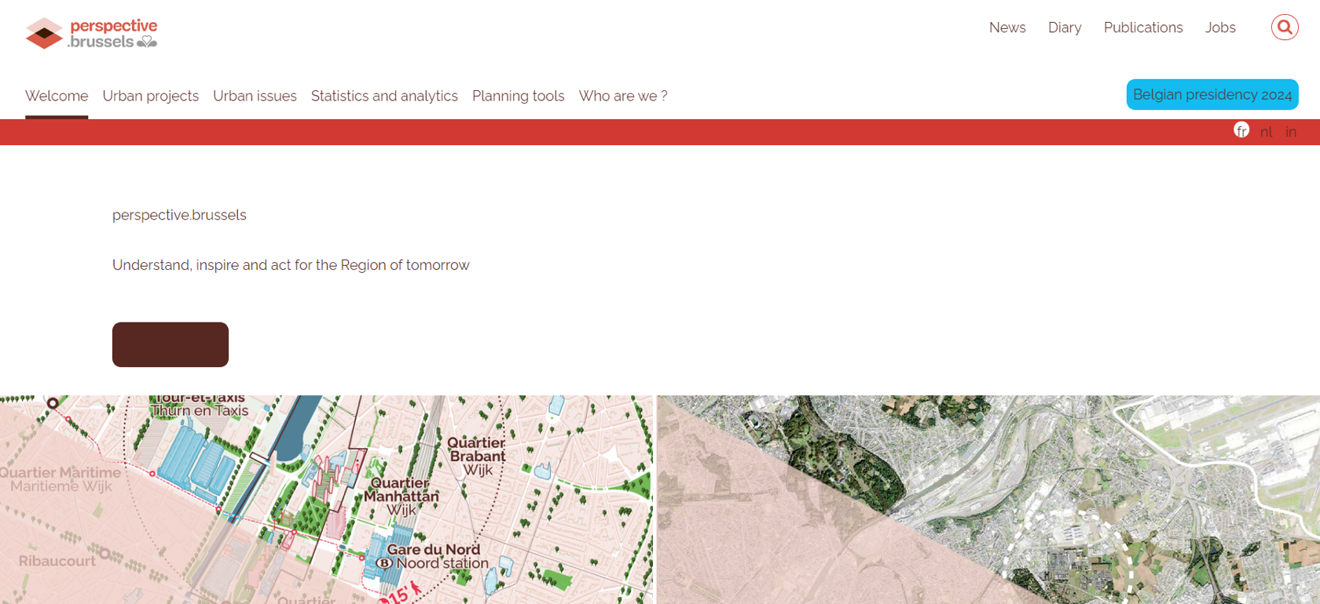
Some examples of urban observatories
Perspective. Brussels, Belgium
https://tanga.cityobservatory.or.tz/

Slide 19
More information ….
https://data.unhabitat.org/pages/urban-observatories
Notes:
Also has:
Links to other data resources such as EO toolkit and Global Municipal Database
Latest statistical facts and upcoming data related trainings

Slide 20
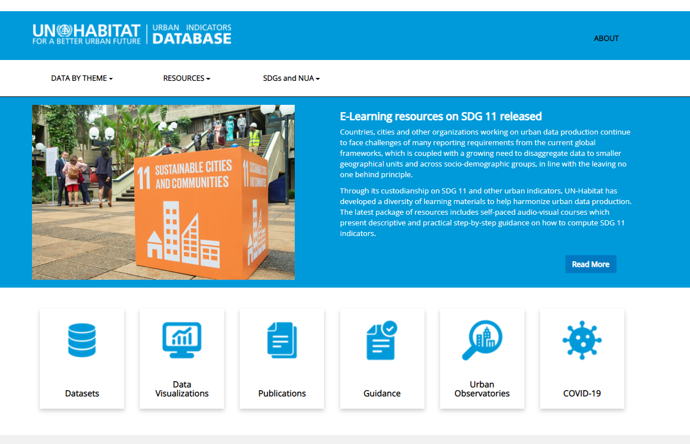
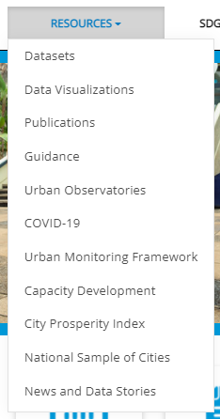
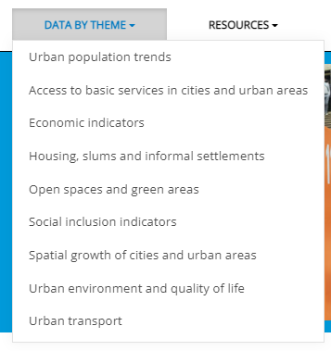
Urban Indicator Database
Home button
Quick links to datasets
Quick links by theme

Slide 21
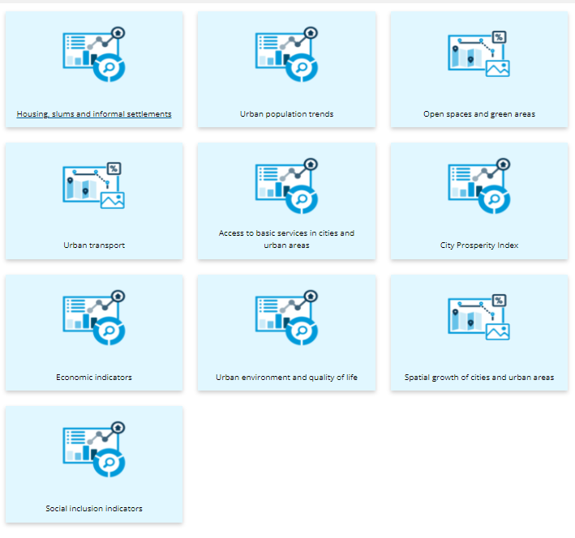
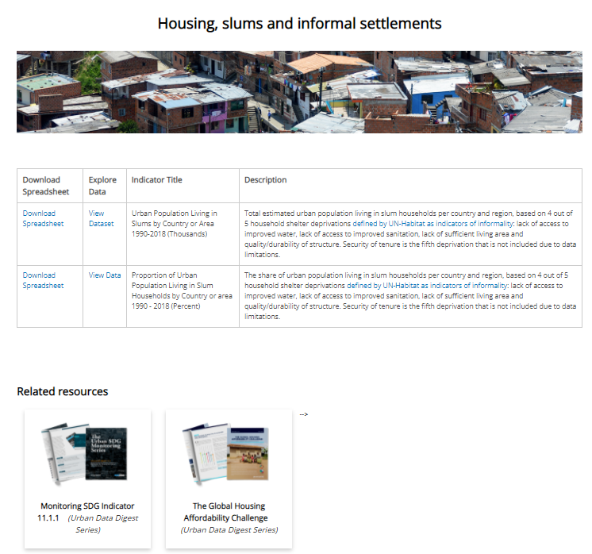
The Urban Indicators Platform: Datasets
Notes:
Data organized by incremental thematic categories

Slide 22
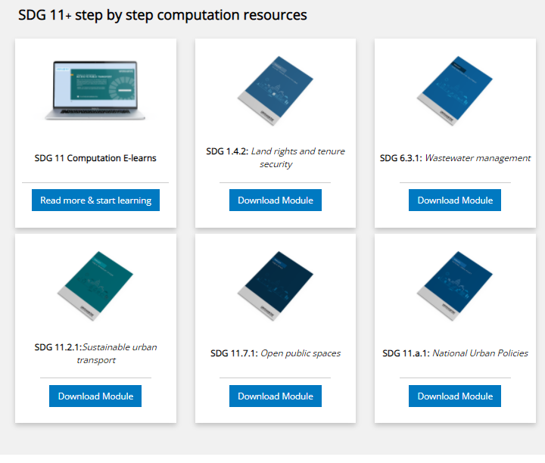
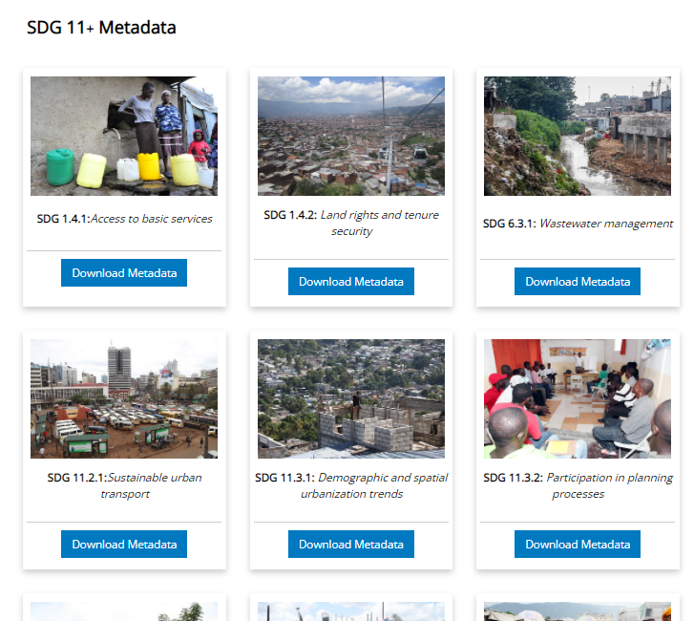
The Urban Indicators Platform: Guidance
Linkages to UN-Habitat learning platform: https://learn.urbanagendaplatform.org/
Notes:
Detailed indicator methodological and step by step documents

Slide 23
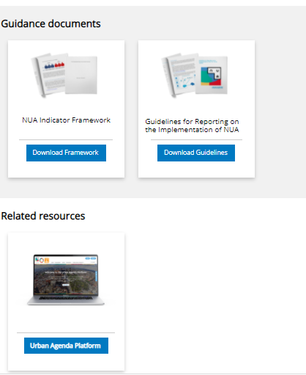
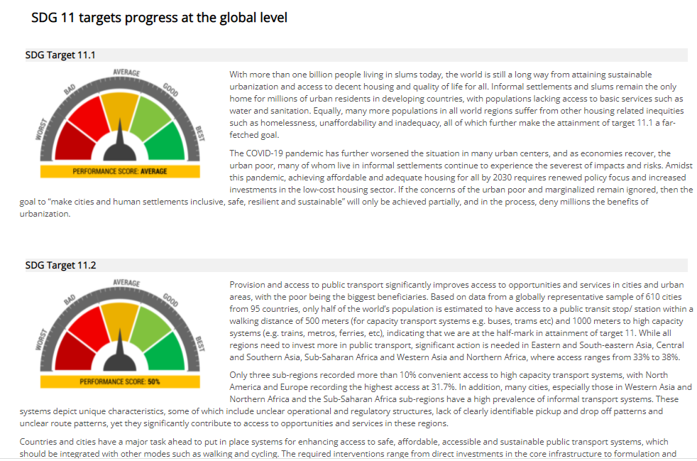
The Urban Indicators Platform: SDGs and NUA
SDG 11 progress tracking and identification of required actions / interventions
Disseminating NUA monitoring information

Slide 24
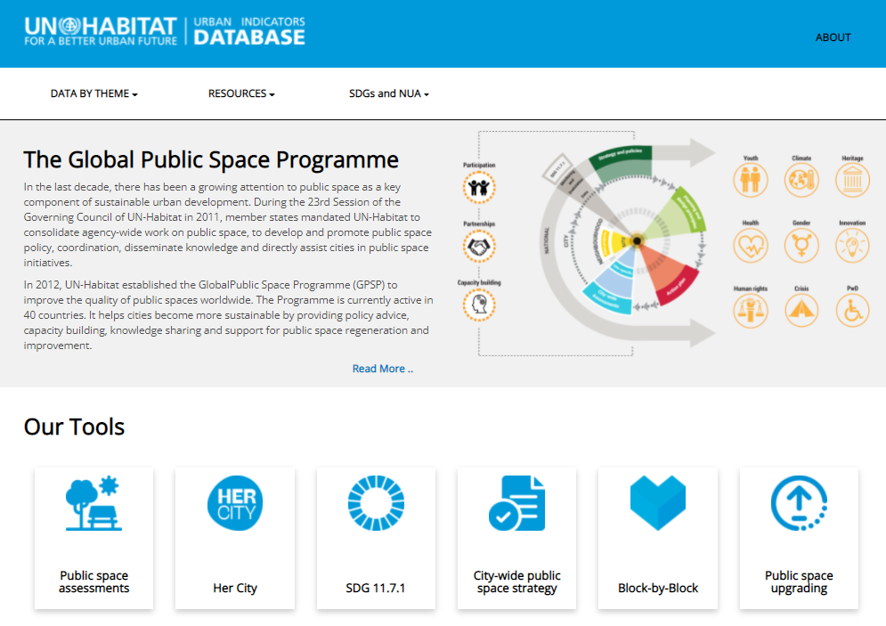
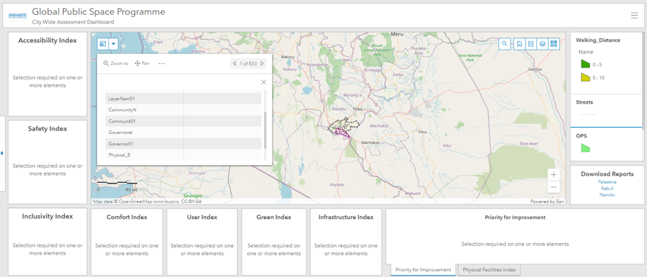
The Urban Indicators Platform: Towards harmonization of UN-Habitat data dissemination
Notes:
GPSP data outlet - coming soon

Slide 25
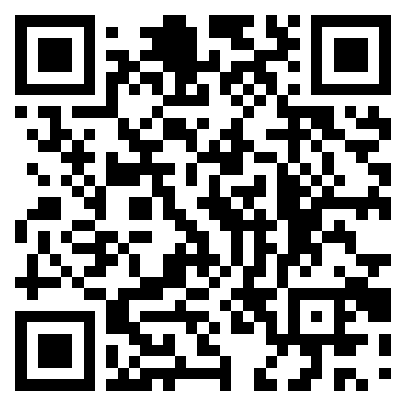
THANK YOU!

